Slide 1
Linked List Implementation of Queue
Lecture #
By: Abdul Aleem
1 / 19

Slide 2


Contents
1
Queue Insertion using Linked List
2
Queue Deletion using Linked List
3
Queue Traversal using Linked List
4
Practice Questions
5
References
2 / 19

Slide 3


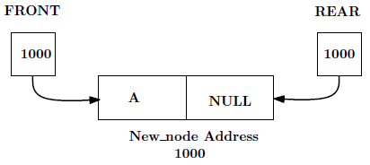
Queue Insertion using Linked List
Insert Operation in Queue using linked list:
Similar to “Inserting an element at the end of a Linked List”. Here two pointers, FRONT and REAR, are maintained.
Initially: FRONT = NULL, REAR = NULL.
Create a node of the Linked list as New node:
Assign FRONT and REAR to hold the New node’s address:
3 / 19

Slide 4
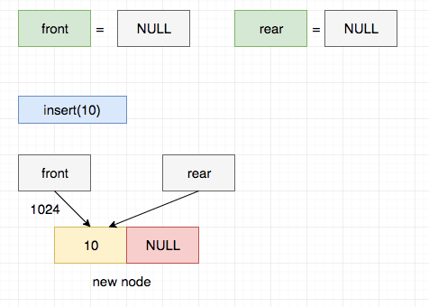
Queue Insertion using Linked List
4 / 19

Slide 5
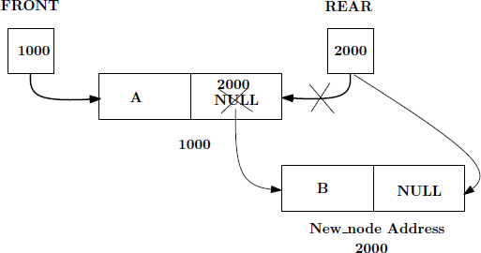
Queue Insertion using Linked List (continued)
(d) Create a new node with node value B:
The newly created node should be inserted at the rear end of the Linked List.
5 / 19

Slide 6
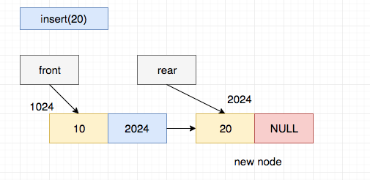
Queue Insertion using Linked List (continued)
The newly created node should be inserted at the rear end of the Linked List. So, the node containing 20 is inserted after 10.

Slide 7
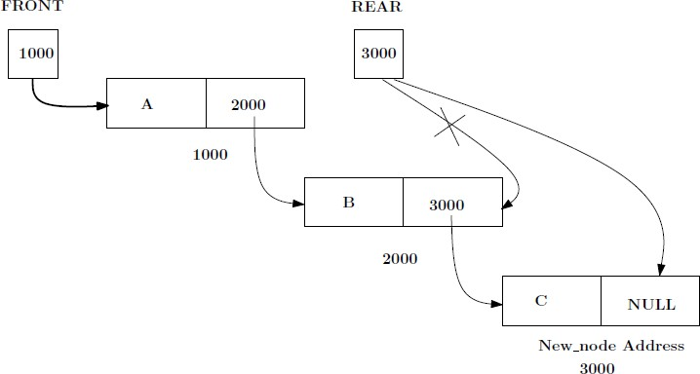
Queue Insertion using Linked List (continued)
(e) Create another node with node value C:
The newly created node should be inserted at the rear end of the Linked List.

Slide 8
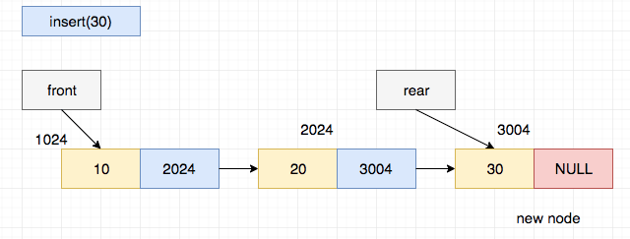
Queue Insertion using Linked List (continued)
The newly created node should be inserted at the rear end of the Linked List.i.e 30 is inserted after 20

Slide 9
Queue Insertion using Linked List Pseudo-code
Pseudo-code for insert operation in queue using linked list:
Step 1: Create a new node as New node Step 2: Node New node= new Node() Step 3: If FRONT == NULL then,
New node.link = NULL FRONT = New node REAR = New node.
Otherwise
REAR.link = New node
REAR = New node.
Step 4: Exit

Slide 10
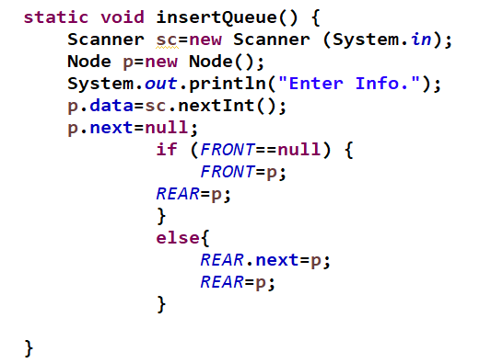
Java Statement for Queue Insertion

Slide 11
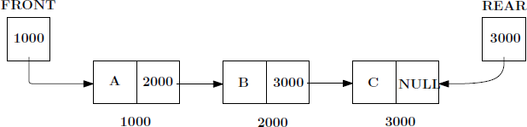
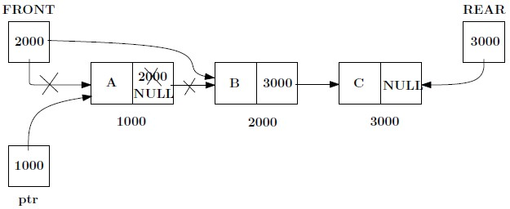
Deletion of Element from Queue using Linked List
Delete Operation in Queue using linked list:
Similar to deleting an element from the front of the linked list. Consider the linked list representation of queue below:
The item to be deleted is A as it is the first element in the queue.
(a) Set: ptr = FRONT, FRONT = FRONT.link, ptr.link = NULL.

Slide 12
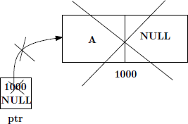
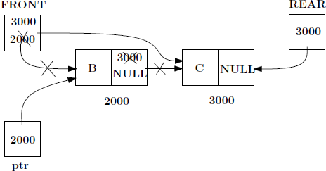
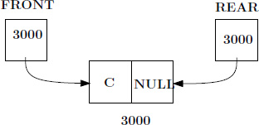
Deletion of Element from Queue using Linked List(Contd.)
(b) Delete the entire node that ptr refers to.
If you want to delete more items, the next element to be deleted is B as it is the element which was inserted next.

Slide 13
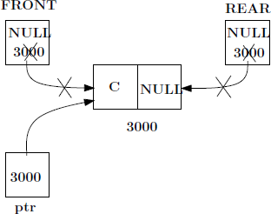
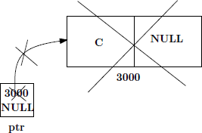

Deletion of Element from Queue using Linked List (continued)
On deleting the node C, the tree becomes empty.
i.e. if FRONT == NULL then, REAR=NULL
So the resultant empty tree can be redrawn as below:

Slide 14
Deletion of Element from Queue using Linked List (continued)
Pseudo-code for delete operation in queue using linked list:
Step 1: If FRONT == NULL then,
Print ”Queue Underflow” and Return Otherwise
ptr = FRONT
FRONT = FRONT.link
ptr.link = NULL.
Step 2: If FRONT == NULL then,
REAR=NULL
Step 3: Exit

Slide 15
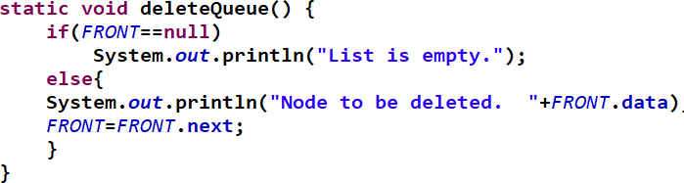
Java Statement for Queue Deletion

Slide 16
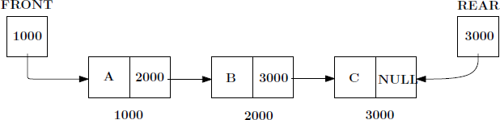
Queue Traversal using Linked List
Traverse Operation in Queue using Array:
Visit each element in the queue starting from FRONT to REAR.
Pseudo-code for traverse operation in queue using linked list:
Step 1: PTR = FRONT
Step 2: while(PTR != NULL)
Print PTR.info PTR = PTR.link [End of loop]
Step 3: Exit
16 / 19

Slide 17
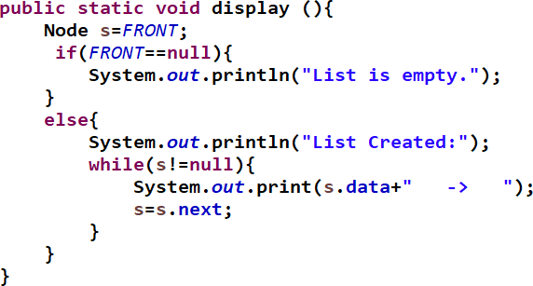
Java Statement for Queue Traversal

Slide 18
Practice Questions
In linked list implementation of queue what is the condition for checking whether the queue is empty or not?
1
If REAR pointer is NULL then the FRONT pointer will contain what
?
2
Write the code to count the number of elements present in linked list implementation of queue.
3
What are the two pointers associated with linked list implementation of queue?
4
A queue contains A, B, C, D. Write the code to insert a new element E using linked list implementation.
5

Slide 19
References
Michael T. Goodrich, Roberto Tamassia, Michael H. Goldwasser ‘Data Structures and Algorithms in Java’, Wiley, 2014.

